Slide 1
LOAN MANAGEMENT USING SQL

Slide 2
What is the project about?
Efficient management of customer loan data
Interest Calculations
CIBIL Score evaluation
Project Objective
Automate loan Processing
Categorizing customers
Apply Interest rates
Maintain CIBIL score
Using Triggers

Slide 3
TABLES IN LOAN MANAGEMENT
Country_state_region
Customer_income_status
Loan_cibilscore_status
Monthly_interest
Customer_info

Slide 4
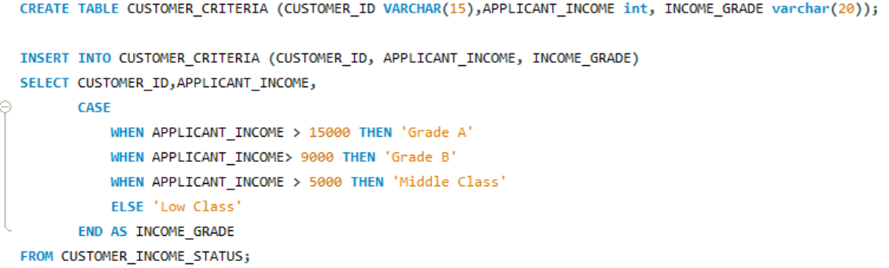
Query for assigning grades

Slide 5
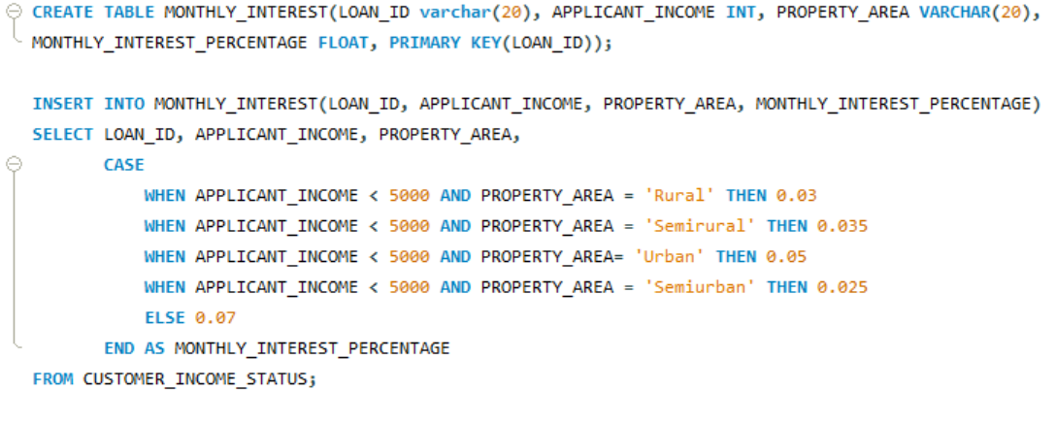
Query for Monthly Interest

Slide 6
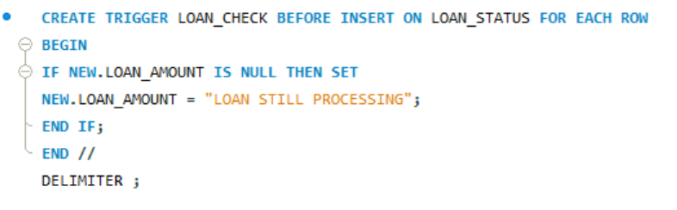
Trigger for Loan Processing

Slide 7
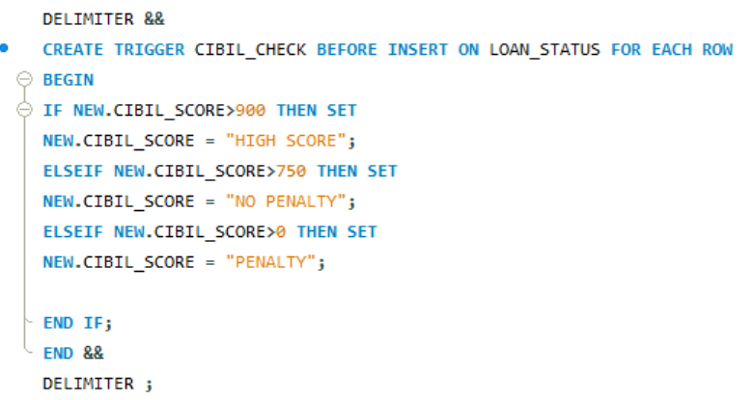
Trigger for Row level Statement

Slide 8
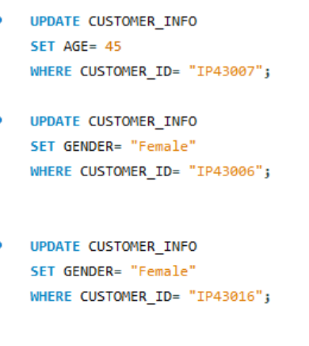
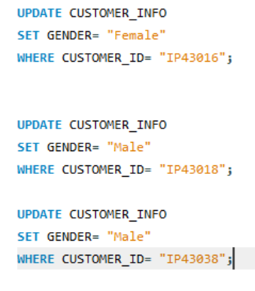
Updating Gender and Customer ID

Slide 9
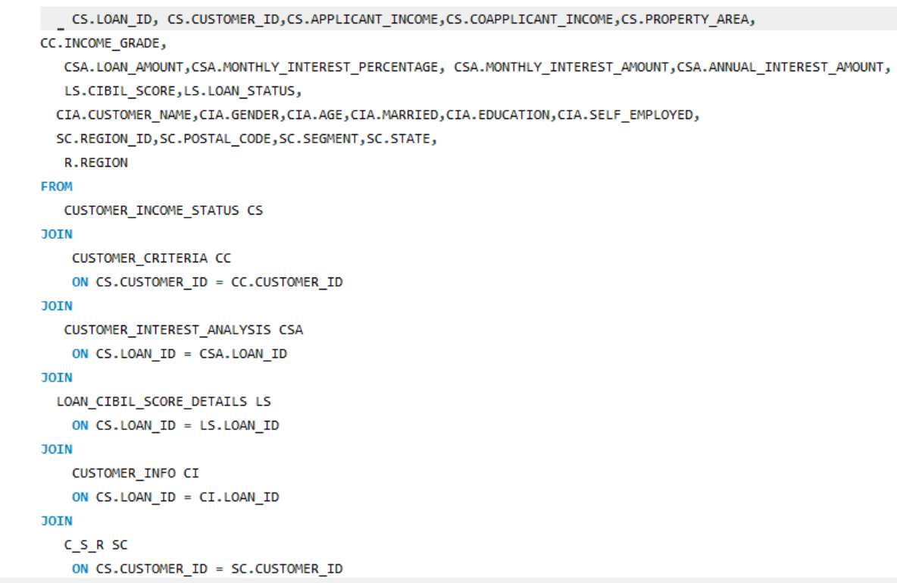
Joins

